Slide 1
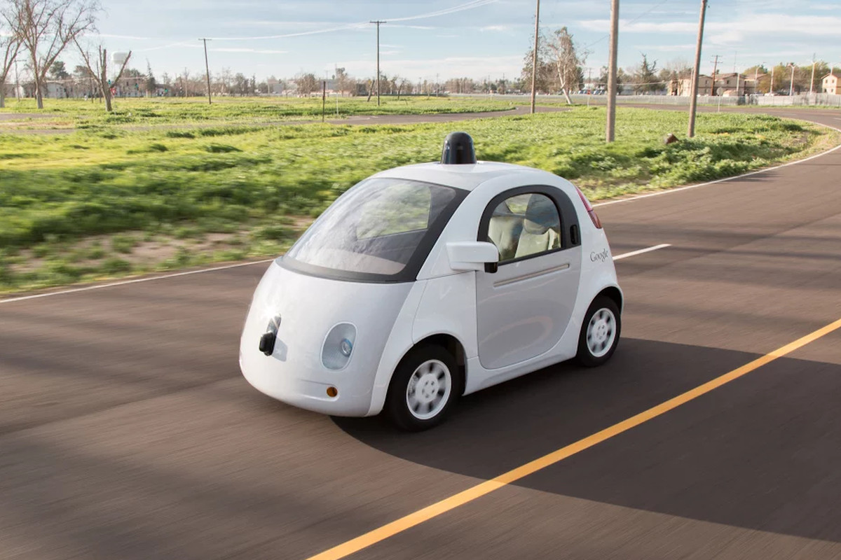
Google Self Driving Car
Name: Ayman Hasib (18201065)

Slide 2
CONTENTS
01
02
03
04
05
06
ABOUT PROJECT
TECHNOLOGY
INTRODUCTION
WORKING PROCESS
ELEMENTS USED
ADVANTAGES & LIMITATIONS

Slide 3
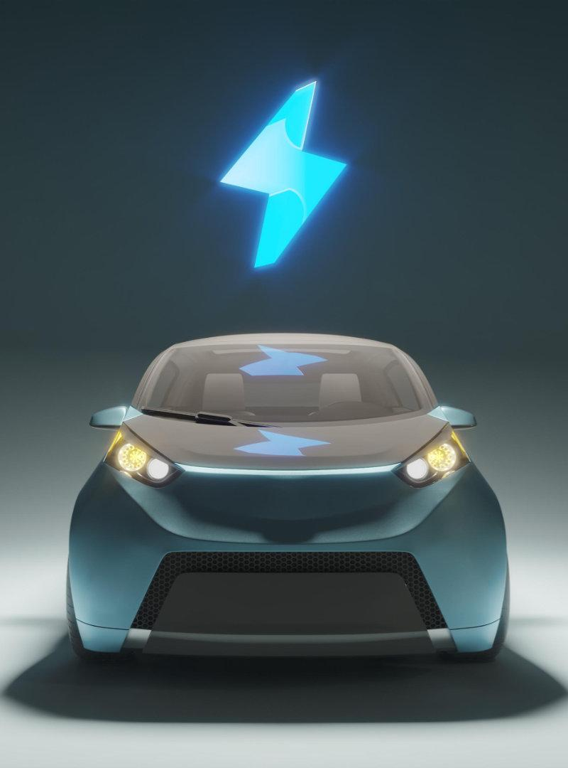
INTRODUCTION
Google self-driving car is a project by google that involves developing technology for mainly electric cars.
It is a technology by which cars can drive automatically without human physical interaction.
The software used for this project is called Google Chauffeur. Google reviled this project publicly in 2020.

Slide 4
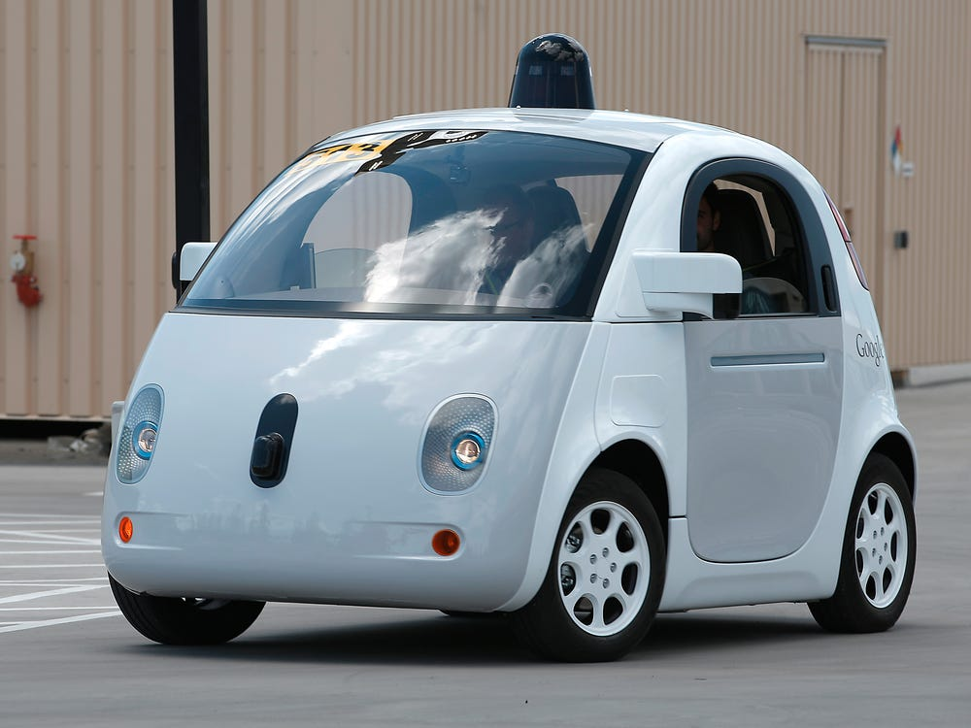
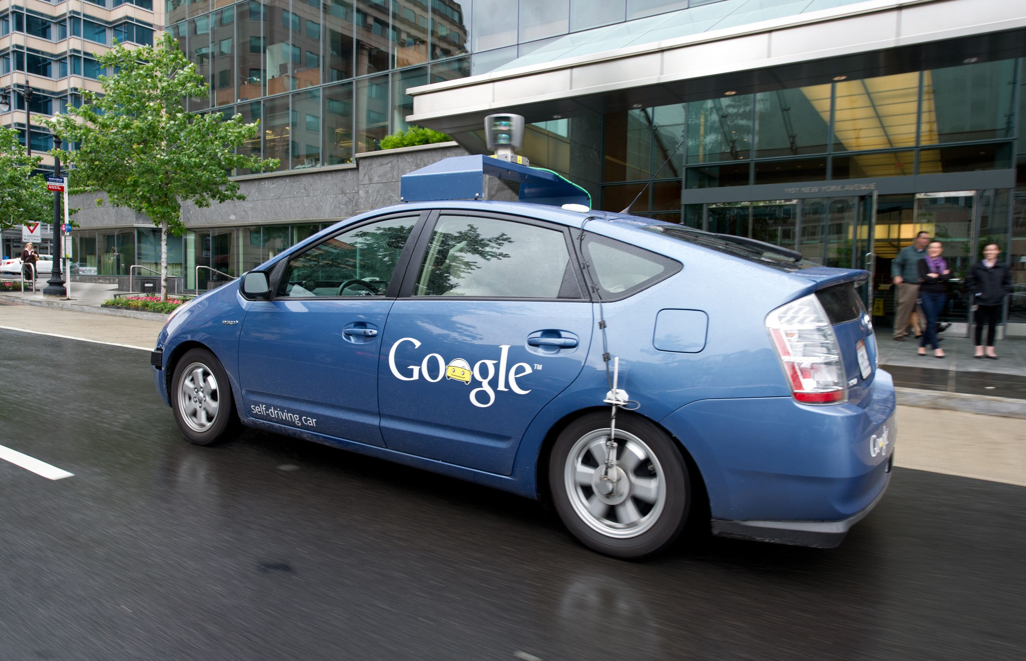
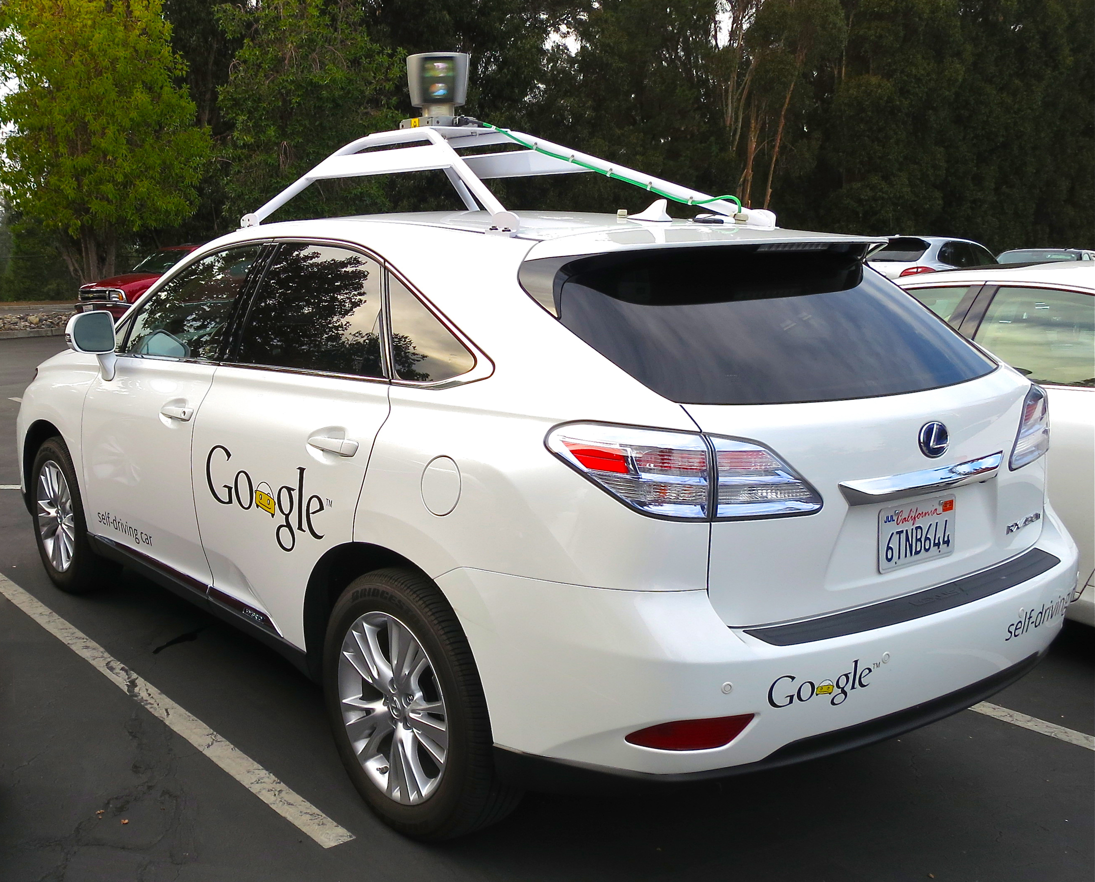
About Project
It is the first truly driverless electric car prototype built by Google which can be available for public use in future. It is a cross car between a Smart Car and a Nissan Micra model car. And they used this car for the first time testing. By this time the project team introduced their system in some other car manufacturing company like TOYOTA model PRIUS, LEXUS model RX450h.
Cross Car
Toyota Prius
Lexus RX450h

Slide 5
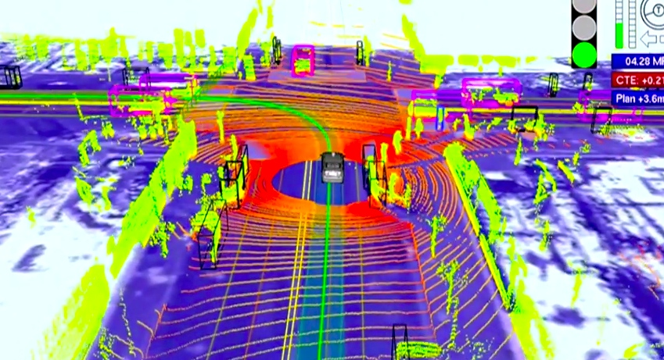
Technology
Google's robotic cars have used approximately $1.5m equipment for their project. They also used the Laser technique by which the vehicle can generate a detailed 3D map of the environment. Then the car takes these generated maps and combines them with high-resolution maps of the world.

Slide 6
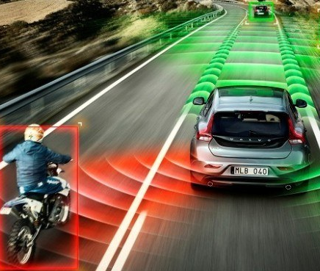
Working Process
The car uses a combination of sensors and software to locate itself in the real.
It also use the GPS system to get the correct location of the car. Beside this GPS, it also use RADAR, LASERS and CAMERAS for getting the 360 degree information's.
This system software can recognise objects, people, cars, road markings, signs and traffic lights, car hazards and many others.

Slide 7
ELEMENTS USED
1
2
3
4
5
LIDER Sensor
Video Cameras
Radar Sensors
Ultrasonic Srnsor
Central Computer

Slide 8
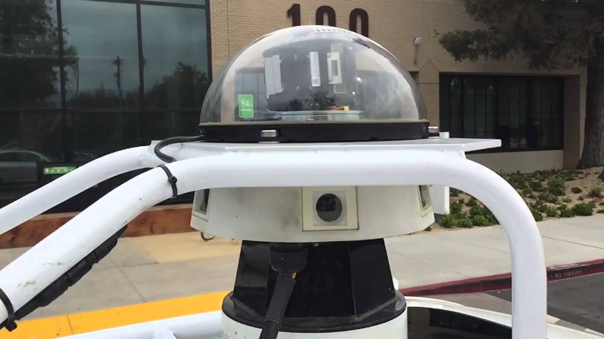
Lidar Sensor
This Sensor is designed for obstacle detection and navigation of autonomous ground vehicles.

Slide 9
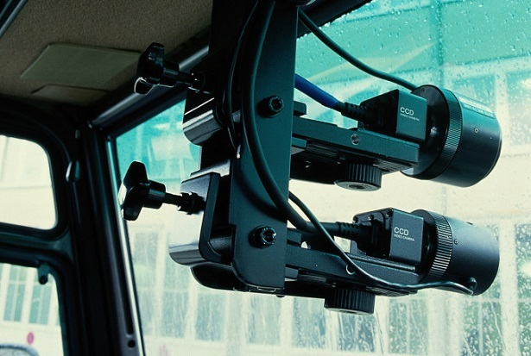
Video Camera
Different types of cameras are installed at various locations of the car. These mainly capture the riders movement and also the outside environment.

Slide 10
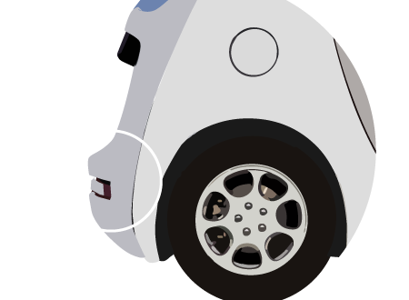
Radar Sensors
The radars are installed at front and back side of the car.

Slide 11
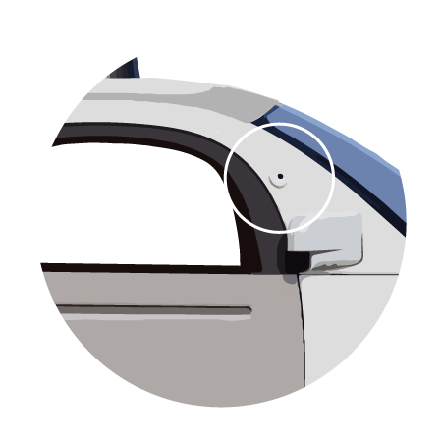
Ultrasonic Sensors
It is use to measure the position of other objects or vehicles. And it also create sound wave to detect the position.

Slide 12
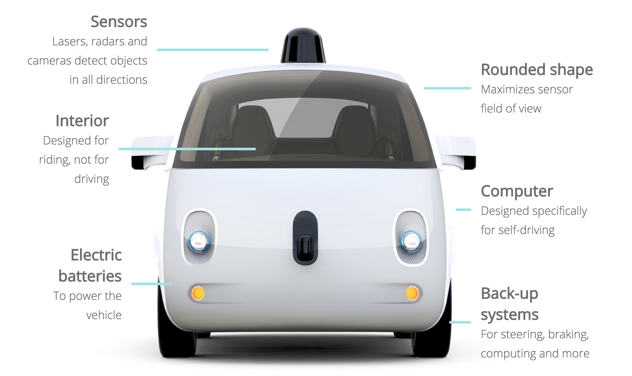
Central Computer
Information from all the Sensors are analysed by a central computer and it controls steering, accelerations and breaks of the car.

Slide 13
Advantages & Limitations
Advantages:
It can managing Traffic flow by using its own map.
It doesn’t need any human physical interaction to drive.
It can determine its own current location.
Limitations:
Due to sensor failure it can change it’s route.
Less security when using Internet, so Hackers can be change routes (in rare cases).
In the tunnel the GPS sensor doesn’t work properly.

Slide 14
THANK YOU!

